Slide 1

Opening a restaurant in Zadar, Croatia
IBM Data Science Professional Certificate Capstone project
Matija Sorić

Slide 2

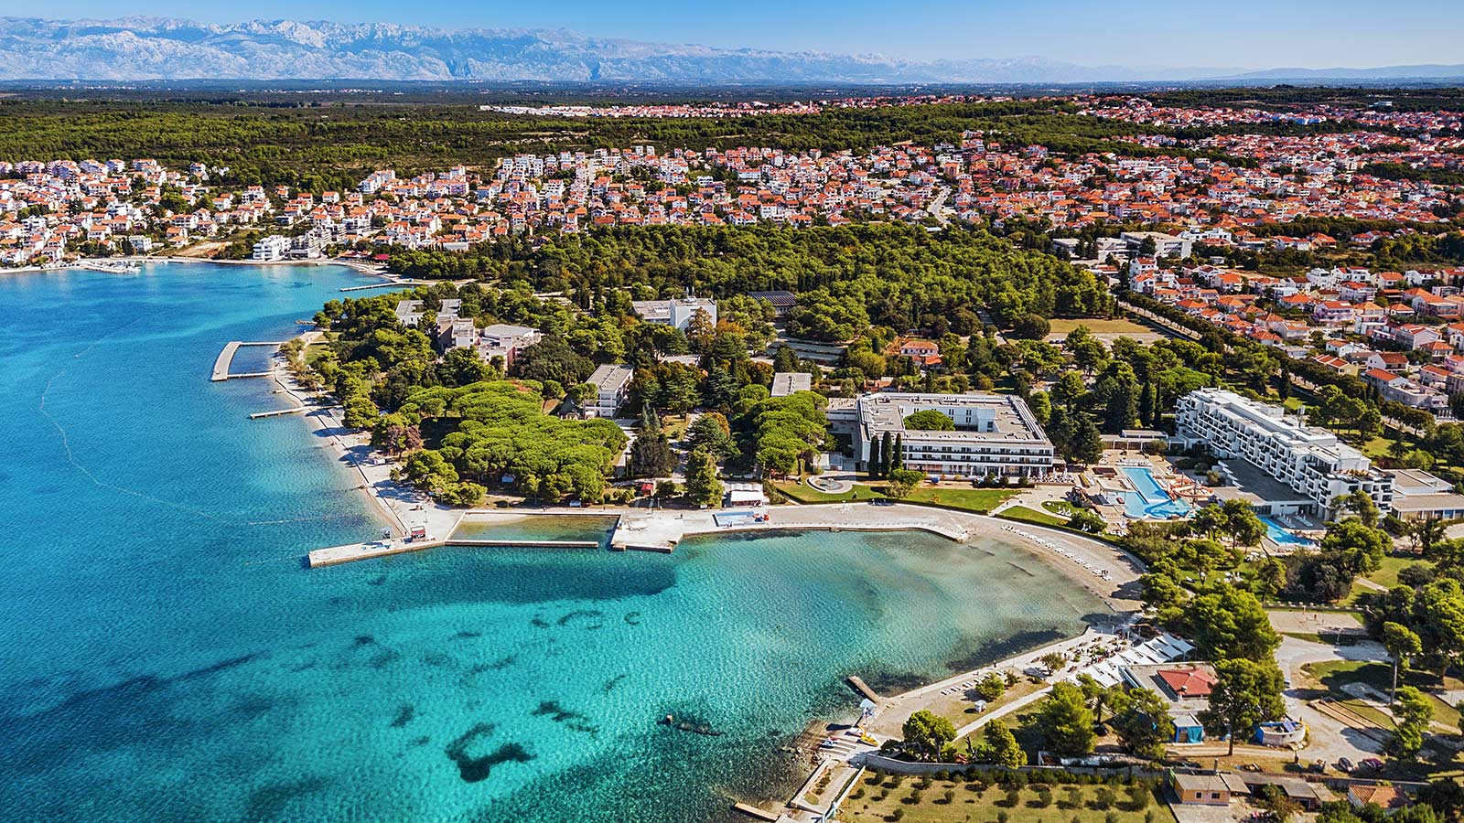
Introduction
Zadar – coastal city in Croatia
popular tourist destination
Facts:
524 500 tourists in 2017
557 600 tourists in 2018
a great opportunity for new tourist businesses

Slide 3

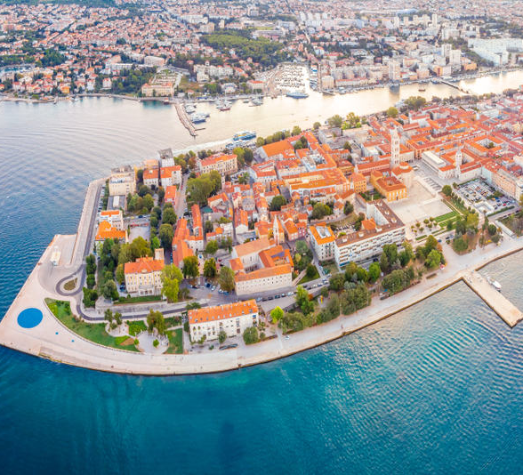
Objective
finding a suitable place for a new restaurant
Problem:
has to be in tourist circulation area → i.e. place where there already exist food venues
has to be in a suitable place where there are not too many restaurants already
optional → desireable to be in a neighborhood where the rent is not so expensive

Slide 4
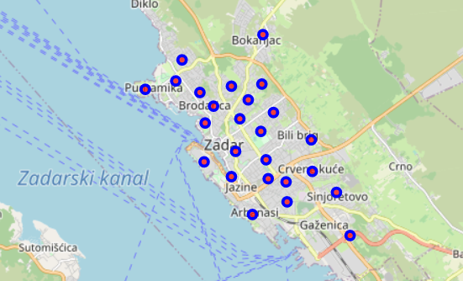
Methodology (data preparation)
Data - 25 geolocations (neighborhoods), with corresponding longitude and latitude values

Slide 5
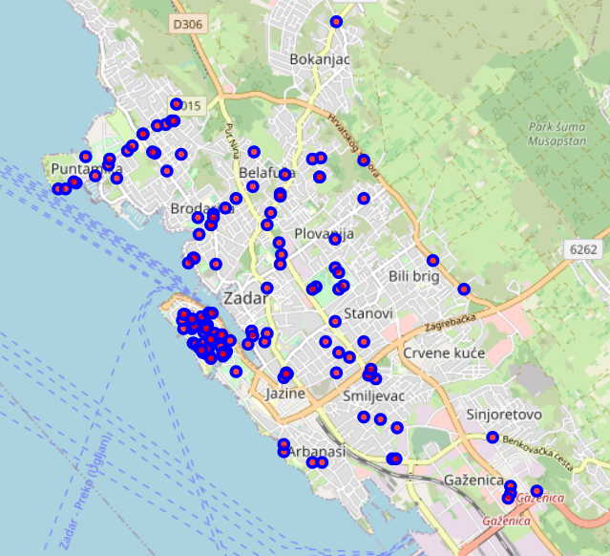
Data used in conjuction with the Foursquare API, to get the venues
Venues combined with the neighborhood data

Slide 6
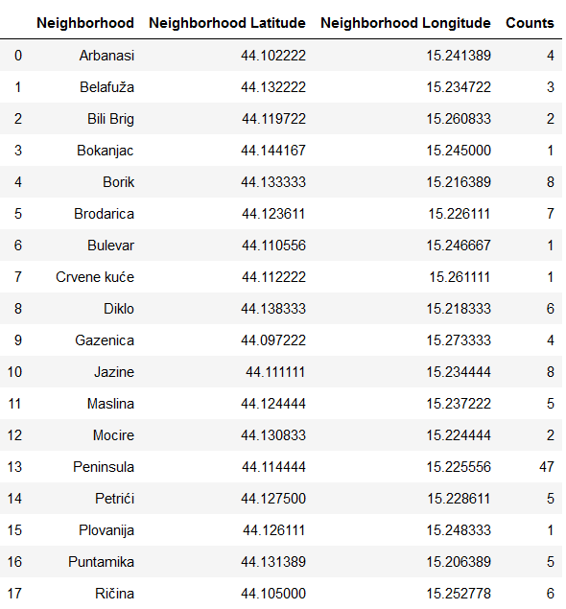
Descriptive analysis
grouping venues by neighborhood
obtaining neighborhoods with the most venues

Slide 7
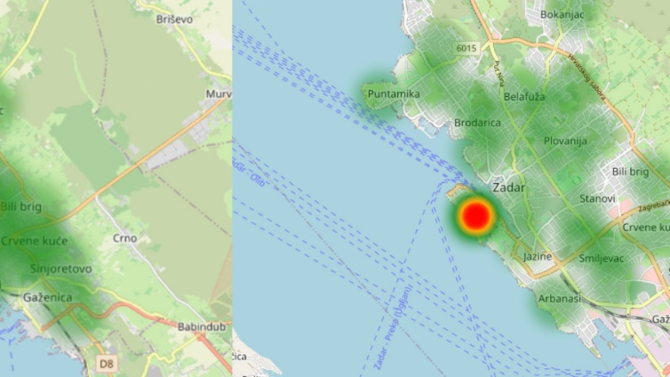
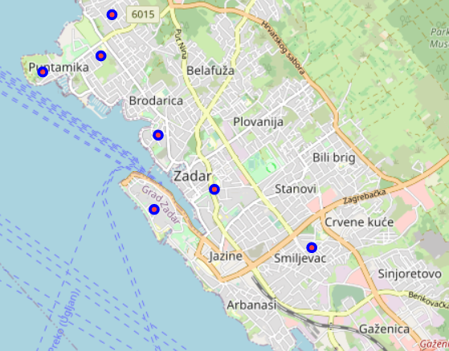
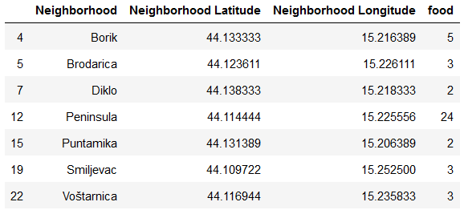
obtaining new dataframe with the most ‘food’ venues

Slide 8
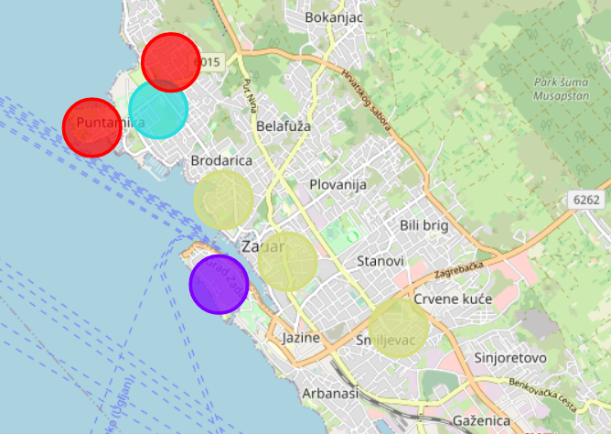
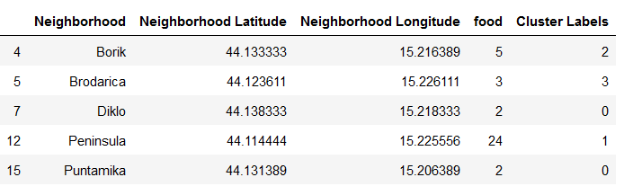
Clustering
Algorithm: K-means
Why apply clustering? To get a better understanding of the neighborhoods and their venues

Slide 9
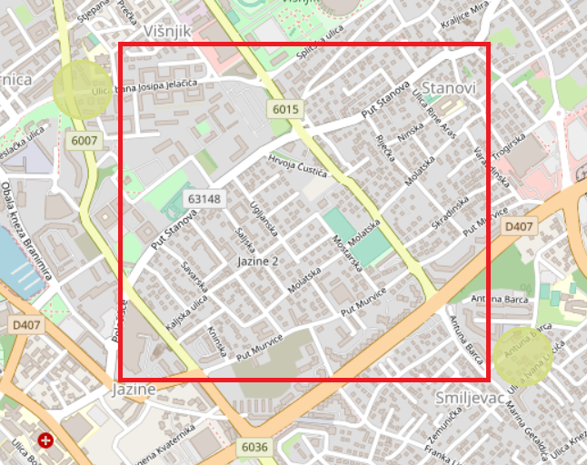
Conclusion
The best place for a new restaurant would be Jazine-Smiljevac-Stanovi-Višnjik quadrant:
It is in the area of the tourist circulation
There are not so many ‘food’ venues in the area
Plus, rent probably cheaper than on peninsula (old city cre)

Slide 10


